Slide 1
HBR OVERVIEW
  MACHINE LEARNING
  AND AI
    What managers should know

Slide 2
About This
HBR Overview
On Google’s first earnings call of 2016, its new CEO, Sundar Pichai, shared his vision for the company’s future: “In the long run,” he told listeners, “I think we will evolve in computing from a mobile-first to an AI-first world.”
That comparison captures the commercial potential of machine learning and artificial intelligence — that they could be as big a technological shift as the introduction of the smartphone. But will AI live up to the hype? Will intelligent software actually transform entire professions and industries? Will it put a significant number of people out of work? And how, exactly, is it different from the “big data” craze that came before it?
We’ve been publishing a lot about machine intelligence, and in this
HBR Overview we’ve selected and summarized some of our most important articles on the subject. This collection explains why machine intelligence is suddenly on the tip of everyone’s tongues, and it begins with a simple but powerful economic framework for understanding what will change. It also contains advice on incorporating machine intelligence into your organization, including where to start and the pitfalls to avoid.
Browse the editorial notes and summaries to find the articles that are most relevant to you. The links to the full articles are on each slide. At the end of the deck, you’ll also find our recommendations for further reading along with discussion questions to share with your team.

Slide 3
CONTENTS
04
  What Machine Learning Is, and
  Why It Matters
    The Simple Economics of Machine Intelligence
    What Artificial Intelligence Can and
    Can’t Do Right Now
07
  Why Now?
    Deep Learning Will Radically Change
    the Ways We Interact with Technology
    Machine Learning Is No Longer Just
    for Experts
11
  How to Get Started
    How to Tell If Machine Learning Can
    Solve Your Business Problem
    7 Ways to Introduce AI into Your Organization
14
  Beware of Bias
    Fixing Discrimination in Online Marketplaces
17
  Are Robots Really Coming for
  Our Jobs?
    How Many of Your Daily Tasks Could
    Be Automated?
    Computers Don’t Kill Jobs but Do
    Increase Inequality
    Experts Have No Idea If Robots Will
    Steal Your Job
23
  Further Reading
24
  Discussion Questions

Slide 4
WHAT MACHINE LEARNING IS, AND WHY IT MATTERS
  Prediction is about to get a lot cheaper

Slide 5
AI, we’re often told, will “change everything.” But how?
In this article, the authors lay out a compelling framework for how that change will take place. Their ideas will stay with you and will help you think more rigorously about how AI will change your business.
What Machine Learning Is, and Why It Matters
The Simple Economics of Machine Intelligence
  Ajay Agrawal, Joshua Gans, and Avi Goldfarb
    NOVEMBER 17, 2016
Technological revolutions tend to involve some important activity becoming cheap, like communication or finding information.
  Machine intelligence is, in its essence, a prediction technology, so the economic shift will center on a drop in the cost of prediction, thus lowering the cost of goods and services that rely on prediction. This matters because prediction is an input to a host of activities including transportation, agriculture, health care, energy manufacturing, and retail.
  When the cost of any input falls so precipitously, there are two other well-established economic implications. First, we will start using prediction to perform tasks where we previously didn’t. Second, the value of other things that complement prediction (namely human judgment) will rise.
Read the full article

Slide 6
What can AI actually do?
If anyone should know, it’s Andrew Ng. He’s led pioneering AI work at Stanford, Google, and most recently Baidu, and in this article he offers a simple, high-level overview of how AI and machine learning actually work.
What Machine Learning Is, and Why It Matters
What Artificial Intelligence Can and Can’t Do Right Now
  Andrew Ng
    NOVEMBER 9, 2016
Almost all of AI’s recent progress is through supervised learning, in which some input data (A) is used to quickly generate some simple response (B).
  Today’s supervised learning software has an Achilles’ heel: It requires a huge amount of data. You need to show the system a lot of examples of both A and B. For instance, building a photo tagger requires anywhere from tens to hundreds of thousands of pictures (A) as well as labels or tags telling you if there are people in them (B). Building a speech recognition system requires tens of thousands of hours of audio (A) together with the transcripts (B).
  What can supervised learning do? Here’s a good rule of thumb: If a typical person can do a mental task with less than one second of thought, we can probably automate it using AI either now or in the near future.
Read the full article

Slide 7
WHY NOW?
  There are two very good reasons
  why AI and machine learning are
  on everyone’s minds:
  Deep learning has pushed the frontier of what machine learning
  can do.
  Machine learning has become democratized.

Slide 8
Many of the AI breakthroughs making headlines today rely on a technology called “deep learning.” It’s mind-numbingly complex, but in this article Aditya Singh offers a short intellectual history of deep learning, as well as an explanation of how it works.
Why Now?
Deep Learning Will Radically Change the Ways We Interact
with Technology
  Aditya Singh
    JANUARY 30, 2017
Deep learning is a branch of artificial intelligence loosely inspired by the mechanics of the human brain. While the idea of deep learning has been around since the 1950s, three developments in the last decade made it viable.
  First, Geoffrey Hinton and other researchers at the University of Toronto developed a breakthrough method for software neurons to teach themselves by layering their training (see graphic on next slide). Second is the sheer amount of data now available—deep learning doesn’t work without lots of data. Finally, a team at Stanford led by Andrew Ng made a breakthrough when they realized that graphics processing unit chips, which were invented for the visual processing demands of video games, could be repurposed for deep learning.
Read the full article

Slide 9
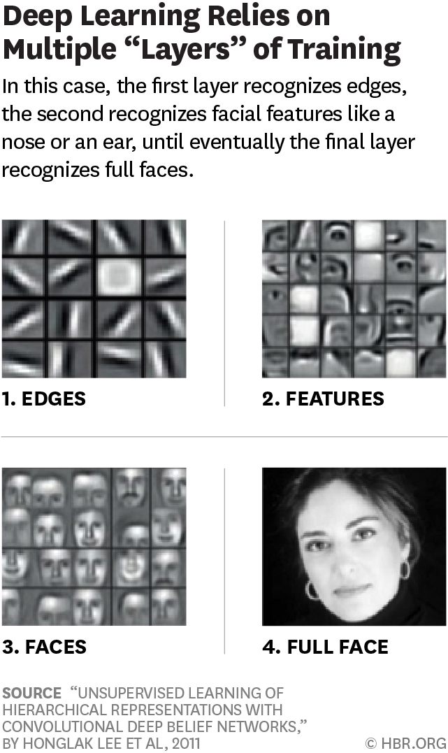
From “Deep Learning Will Radically Change the Ways We Interact with Technology”
Why Now?

Slide 10
The barrier to entry for using machine learning has decreased dramatically in recent years, similar to what happened to software development decades ago.
Why Now?
Machine Learning Is No Longer Just for Experts
  Josh Schwartz
    OCTOBER 26, 2016
Breakthroughs in deep learning aren’t the only reason this is a big moment for machine learning. Just as important is that over the last five years machine learning has become far more accessible to nonexperts, opening up access to a vast group of people.
  In many ways, this change in accessibility mimics the progression we’ve seen in software development as a whole. Over the last 50 years, software development has gradually migrated from “low-level” languages—highly technical languages that closely relate to a computer’s underlying architecture—to high-level languages with significantly lower barriers to entry.
  This isn’t to say that experts will become obsolete. Accessibility creates a virtuous cycle. Use by nonexperts creates even more demand for easier-to-use systems and uncovers new applications of machine learning, which inspires further research and development by experts.
Read the full article

Slide 11
Machine Learning and AI
HOW TO GET STARTED
  Not every problem calls for machine learning

Slide 12
When all you have is a hammer, every problem starts to look like a nail. But not all your business problems are machine learning problems and not all automation requires AI. In this article Anastassia Fedyk helps readers tell the difference.
How to Get Started
How to Tell If Machine Learning Can Solve Your
Business Problem
  Anastassia Fedyk
    NOVEMBER 25, 2016
Start by distinguishing between automation problems and learning problems. Machine learning can help automate your processes, but not all automation problems require learning. Automation without learning is appropriate when the problem is relatively straightforward.
  So what are good business problems for machine learning methods? Essentially, any problem that:
  (1) requires prediction rather than causal inference; and (2) is sufficiently self-contained, or relatively insulated from outside influences.
Read the full article

Slide 13
Build or buy? It’s the classic technology adoption question, and in this piece Thomas Davenport updates it for the AI era. Both are options, and some companies are doing both.
How to Get Started
7 Ways to Introduce AI into Your Organization
  Thomas H. Davenport
    OCTOBER 19, 2016
Getting started with cognitive technologies is getting easier all the time. Many vendors have jumped into the field, and its offerings provide options for any company wanting to make their processes or products smarter.
  There are at least seven ways to begin using cognitive tools, although some are clearly easier (and cheaper) than others. Because implementing these technologies is a key factor in deciding how to move forward, the cognitive entry points can be sorted into three categories: “Mostly Buy,” “Mostly Build,” and “Some Buy, Some Build.”
Read the full article

Slide 14
Machine Learning and AI
BEWARE OF BIAS
  Algorithms are not neutral, and
  that can cause big problems if
  you’re not careful

Slide 15
Algorithms often make impressively accurate predictions. But that doesn’t mean they’re objective. In fact, lots of AI systems are built on biased data.
Beware of Bias
Fixing Discrimination in Online Marketplaces
  Ray Fisman and Michael Luca
    DECEMBER 2016 ISSUE
The search results Google serves up, the books Amazon suggests, and the movies Netflix recommends are all examples of machines replacing imperfect human judgment about what customers want. It’s tempting to assume that eliminating human judgment would eliminate human bias as well. But that’s not the case.
  In fact, algorithm-generated discrimination occurs in ways that humans would probably avoid.
  In an eye-opening study, computer science professor Latanya Sweeney sought to understand the role of race in Google ads. She searched for common African-American names—such as Deshawn and Latanya—and recorded the ads that appeared with the results. She then searched for names, such as Geoffrey, that are more common among whites. The searches for black-sounding names were more likely to generate ads offering to investigate possible arrest records.
    Continued on next slide
Read the full article

Slide 16
Any company that has an AI strategy needs a strategy for addressing the biases in its systems. In this article Ray Fisman and Michael Luca explain how to create one.
Beware of Bias
    Continued from previous slide
When designing machine learning products, consider these two guiding principles:
Principle 1: Don’t ignore the potential for discrimination. Platforms should start by being more careful with their tracking. Currently, most don’t know the racial and gender composition of their transaction participants. A regular report (and an occasional audit)
on the race and gender of users, along with measures of each group’s success on the platform, is a necessary (though not sufficient) step toward revealing and confronting any problems.
Principle 2: Maintain an experimental mindset. Platforms should do what they do best—experiment.
To test design choices and other inventions that may influence the extent of discrimination, companies should conduct randomized controlled trials. Airbnb should be applauded for a recent experiment in withholding host photos from its main search results page to explore the effects on booking outcomes (although it has not made the results public).
Read the full article

Slide 17
Machine Learning and AI
ARE ROBOTS REALLY COMING FOR OUR JOBS?
  No one knows for sure

Slide 18
Don’t think about AI taking jobs. Think about AI taking over tasks. That alone is a big improvement on much of the “robots stealing jobs” conversation. This piece is a clear-eyed exploration of what can and can’t be automated with today’s technologies. Your entire job may not be automatable, but many of the tasks you do likely are.
Are Robots Really Coming for Our Jobs?
How Many of Your Daily Tasks Could Be Automated?
  Michael Chui, James Manyika, and Mehdi Miremadi
    DECEMBER 14, 2015
Smart machines have already demonstrated the ability to see patterns in information, understand what humans are saying (responding to a query like ‘Show me’ where sales rose the most last week”), and manipulate physical objects. Once these capabilities are applied to various work activities, few occupations or organizations will remain untouched (see graphic on next slide).
  The overarching implication from research into task automation is that roles will be redesigned and organizations will have to become very good at understanding where machines can do a better job, where humans have the edge, and how to reinvent processes to make the most of both types of talent. The largest benefits of information technology accrue to organizations that analyze their processes carefully to determine how smart machines can enhance and transform them—rather than organizations that simply automate old activities. This is a lesson that it took us a long time to learn in earlier IT revolutions and that bears repeating.
Read the full article

Slide 19
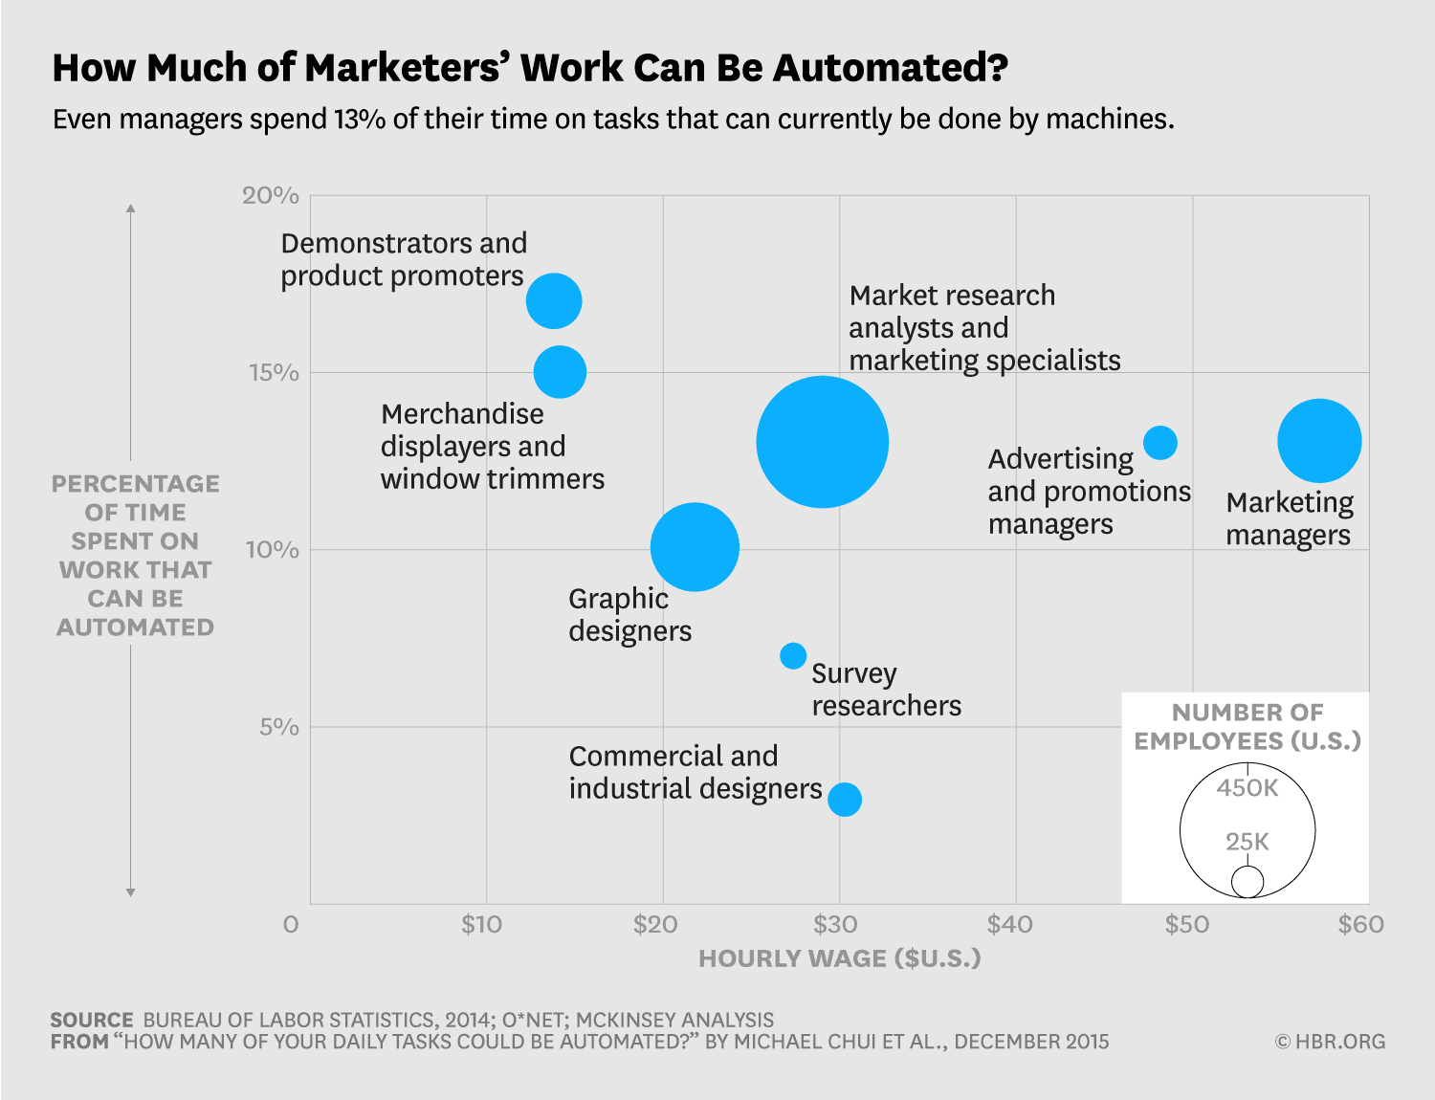
From “How Many of Your Daily Tasks Could Be Automated?”
Are Robots Really Coming for Our Jobs?

Slide 20
Automation has historically destroyed some jobs but created others. But that doesn’t mean it’s benign. James Bessen explains how automation has contributed to rising income inequality. And if AI lives up to expectations, that may get a lot worse.
Are Robots Really Coming for Our Jobs?
Computers Don’t Kill Jobs but Do Increase Inequality
  James Bessen
    MARCH 24, 2016
One way computers could cause inequality is by eliminating jobs, leading to high unemployment, which in turn leads to lower wages. But that is not what is going on, especially now that unemployment is low again.
  Instead, new computer technologies require major new skills. Workers who learn these skills see their wages grow, but many workers have difficulty acquiring the new skills. And their wages have been stagnant, leading to a growing wage gap.
  Automation has become a concern not just for blue-collar manufacturing workers but also for white-collar workers and even professionals. New computer programs, some using artificial intelligence, are taking over tasks for bookkeepers, bank tellers, clerks, and others.
Read the full article

Slide 21
There’s still a lot we don’t know about what AI will mean for the labor market. Estimates of job loss, task automation, and effects on wages are important but highly uncertain. The history of technology is filled with predictions about how it would impact workers that turned out to be wrong.
Are Robots Really Coming for Our Jobs?
Experts Have No Idea If Robots Will Steal Your Job
  Walter Frick
    AUGUST 8, 2014
A grain of salt is called for whenever prognosticators claim to know which jobs will be automated and which won’t. These exercises are valuable in that they help people think through the role of automation in society, but the truth is we simply don’t know how many jobs of which kinds will be automated when.
  A 2014 Pew survey confirms as much (see graphic on next slide). Experts were thoroughly divided over the question “Will networked, automated, artificial intelligence (AI) applications and robotic devices have displaced more jobs than they have created by 2025?”
  In their book The Second Machine Age, Erik Brynjolfsson and Andrew McAfee highlight how predictions made in 2004 failed to predict even today’s division of labor between people and machines. Economists had theorized that computers would handle arithmetic and rule-based work, while humans would be required for pattern recognition—like driving—as well as communication. Today, self-driving cars are starting to appear on the roads and speech recognition is embedded in every smartphone.
Read the full article

Slide 22
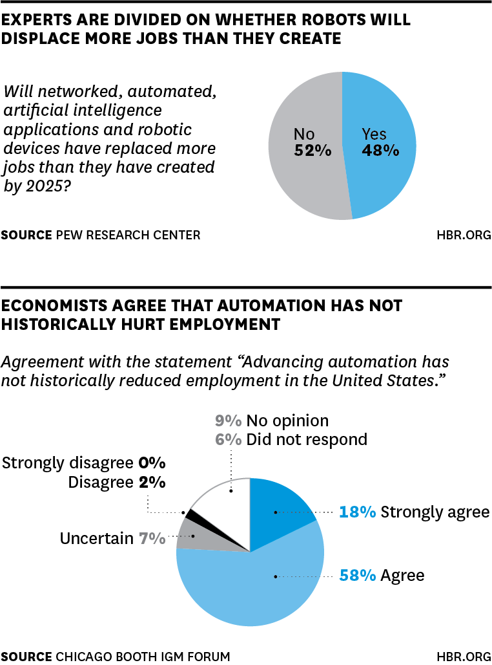
From “Experts Have No Idea If Robots Will Steal Your Job”
Are Robots Really Coming for Our Jobs?

Slide 23

FURTHER READING
What Machine Learning Is,
and Why It Matters
  What Every Manager Should Know About Machine Learning
    Mike Yeomans
  A Refresher on Regression Analysis
    Amy Gallo
  How Machines Learn (And You Win)
    Randal S. Olson
Why Now?
  The First Wave of Corporate AI Is Doomed to Fail
    Kartik Hosanagar and Apoorv Saxena
How to Get Started
  Hiring Your First Chief AI Officer
    Andrew Ng
  Please Don’t Hire a Chief Artificial Intelligence Officer
    Kristian J. Hammond
  How to Win with Automation (Hint:
  It’s Not Chasing Efficiency)
    Greg Satell
  The Trade-Off Every AI Company
  Will Face
    Ajay Agrawal, Joshua Gans, and
    Avi Goldfarb
  How Artificial Intelligence Will
  Redefine Management
    Vegard Kolbjørnsrud, Richard Amico, and Robert J. Thomas
Beware of Bias
  Hiring Algorithms Are Not Neutral
    Gideon Mann and Cathy O’Neil
  A Guide to Solving Social Problems with Machine Learning
    Jon Kleinberg, Jens Ludwig, and Sendhil Mullainathan
  New Evidence Shows Search Engines Reinforce Social Stereotypes
    Jahna Otterbacher
Are Robots Really Coming
for Our Jobs?
  The Countries Most (and Least) Likely to be Affected by Automation
    Michael Chui, James Manyika, and Mehdi Miremadi
  Thinking Through How Automation
  Will Affect Your Workforce
    Ravin Jesuthasan and John Boudreau
  Robots and Automation May Not Take
  Your Desk Job After All
    Dan Finnigan
  Automation Will Make Us Rethink What a “Job” Really Is
    Ravin Jesuthasan, Tracey Malcolm, and George Zarkadakis
  Prepare Your Workforce for the
  Automation Age
    Christoph Knoess, Ron Harbour, and Steve Scemama
Tell Us What You Think!
We’d love to get your feedback on this HBR Overview with this brief survey.

Slide 24
DISCUSSION QUESTIONS
Of all the tasks you perform at work, which seem the most easily automatable? Which are routine? Which can be performed in under a second of thought?
Does your existing data team have the skills required to begin experimenting with machine learning?
Does your organization traditionally prefer to build or buy its technology?
What biases might be embedded in the data you’ve collected that you’ll use to train machine learning algorithms?
Are competitors in your industry using machine learning already? What for?

